Slide 1
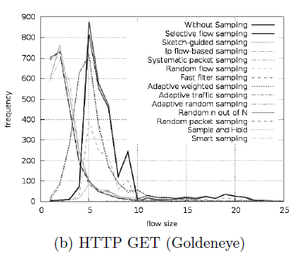
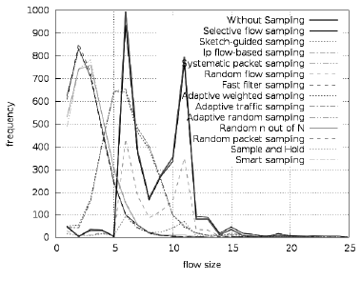
The Impact of Sampling Techniques on Application Level DoS Attack Detection
Hossein Hadian Jazi, Hugo Gonzalez, Natalia Stakhanova, and Ali A. Ghorbani
Faculty of Computer Science, University of New Brunswick
Problem Statement
Application layer DoS
Less resources
Stealthier
Targeted damage
Less detectable
In 2013 represented more
than 20% of all attacks.
Our focus
Traditional focus: network characterization for load balancing purposes
Intrusion detection domain:
many traditional techniques are repurposed
several specialized techniques were introduced
Impact of sampling techniques on detection of application layer denial-of-service attacks.
Data
Sampling Techniques overview
Generate application layer DoS attacks intermixed with the attack-free traces from the ISCX set.
Sampling technique | Sampling level | Tailored for security domain | Flow/packet size preference
Systematic packet sampling | Packet | No | No Preference
Random packet sampling | Packet | No | No Preference
Random n-out-of-N sampling | Packet | No | No Preference
Adaptive random sampling | Packet | No | Medium size
Random flow sampling | Flow | No | No Preference
Smart sampling | Flow | No | Large
Sample-and-hold | Hybrid | No | Large
Sketch-guided sampling | Hybrid | No | Small/ Medium
Selective flow sampling | Flow | Yes | Small
Fast filtered sampling | Hybrid | Yes | Small
IP flow-based sampling | Hybrid | Yes | Small/ Medium
Adaptive weighted sampling | Packet | Yes | No Preference
Adaptive traffic sampling | Hybrid | Yes | Small
Application DoS attack | Num of cases | Average duration | Average # of pkts | Average # of fows | Average flow size (pkt)
High-volume HTTP attacks
DoS improved GET (Goldeneye) | 3 | 452s | 6084 | 864 | 7
DDoS GET(ddossim) | 2 | 138s | 46081 | 22103 | 2
DoS GET (hulk) | 4 | 546s | 8482 | 1085 | 8
Low-volume HTTP attacks
Slow-send body (Slowhttptest) | 4 | 834s | 9106 | 615 | 15
Slow send body (RUDY) | 4 | 65s | 7066 | 834 | 8
Slow-send headers (Slowhttptest) | 5 | 575s | 25503 | 2917 | 9
Slow send headers (Slowloris) | 2 | 150s | 12518 | 1881 | 7
Slow-read (Slowhttptest) | 2 | 404s | 29103 | 2626 | 11
Detection
Employed a nonparametric cumulative sum (CUSUM) procedure
Commonly used for detection of network-layer DoS attacks
Simple with low computational overhead
Impact of Sampling on Detection
Our experiment shows that selective flow sampling designed for anomaly detection achieved the best detection performance. This performance however came at the expense of high resource consumption. Two other less 'expensive' alternatives are the specialized IP flow-based sampling method and the sketch-guided sampling which is a more generic approach aimed at accurate traffic estimation.
Sampling technique | Flow percentage: 30% |  | Flow percentage: 20%
 | DR | # False alert | DR | # False alert
Without sampling | 100 | 0 | 100 | 0
Selective flow sampling | 100 | 0 | 84.61 | 0
Sketch-guided sampling | 88.46 | 1 | 84.61 | 7
IP flow-based sampling | 88.46 | 2 | - | -
Systematic packet sampling | 84.61 | 15 | 73.07 | 18
Random flow sampling | 80.76 | 0 | 69.23 | 0
Fast filter sampling | 80.76 | 12 | 76.92 | 12
Adaptive weighted sampling | 80.76 | 12 | - | -
Adaptive traffic sampling | 80.76 | 12 | - | -
Adaptive random sampling | 80.76 | 12 | 73.07 | 16
Random n out of N packet sampling | 80.76 | 15 | 76.92 | 17
Random packet sampling | 76.92 | 13 | 76.92 | 17
Sample and hold | 38.46 | 0 | 7.69 | 0
Smart sampling | 0 | 0 | 0 | 0

